Slide 1





GENSPARK
8-HOUR TRAINING MODULE
Day 1 — Databricks Quality Engineering Strategy & Architecture
Databricks-Native Strategy & Architecture Patterns
Native Validation: Delta Constraints, DLT & Workflows
8 Hours | Interactive Strategy + Labs
Presented by: Ajay
Date: January 2026 Enterprise Quality Practice

Slide 2









Day 1 Agenda & Outcomes
Databricks Quality Engineering Strategy & Architecture
01
08:30 – 09:00
02
09:00 – 10:15
03
10:30 – 11:45
Kickoff & Objectives
Strategy on Databricks
Architecture
Session goals, success criteria, and aligning on the day's roadmap.
QE pillars (Trust, Velocity, Compliance) and defining Lakehouse KPIs.
Reference patterns, governance with Unity Catalog, and CI/CD gates.
04
12:45 – 14:45
05
15:00 – 16:30
06
16:30 – 17:00
Module 1: Blueprint
Native Validation
Labs & Wrap-up
Deep dive: Enterprise Lakehouse Quality Engineering Blueprint & RFP Strategy.
DLT expectations, Delta constraints, and monitoring patterns.
Hands-on exercises, Q&A, and readiness checklist review.
TARGET OUTCOMES
Operating model & RACI defined
Reference architecture agreed
Native validation patterns
Day 1 Goals
Lab readiness confirmed
KPI & SLO baseline set
RFP scoring rubric mastery
Confidential — Internal Training Material
Page 2

Slide 3





Learning Objectives & Success Criteria
What we will achieve in this 8-hour strategy and architecture session
Define QE Strategy
Success Criteria
Tailor a Quality Engineering strategy specifically for the Databricks Lakehouse, moving beyond traditional warehouse QA approaches.
Documented QE operating model & RACI
Map Controls to Architecture
Reference architecture diagram agreed
Align quality gates with native components: Unity Catalog for governance, DLT for pipeline health, and Workflows for orchestration.
KPI/SLO baseline defined and tracked
Implement Native Validation
Hands-on labs completed successfully
Learn to apply Delta constraints, DLT expectations, and automated monitoring patterns for both batch and streaming workloads.
KEY DELIVERABLES
Strategy Deck
RACI Matrix
Architecture V1
Lab Notebooks
Day 1 — Databricks Quality Engineering Strategy & Architecture
Confidential & Proprietary

Slide 4




SECTION 01
Strategy — Lakehouse Quality Engineering
Defining the strategic pillars that drive trust, ensure velocity, and guarantee compliance on the Databricks Data Intelligence Platform.
Strategic Alignment Model
PILLAR 1
PILLAR 2
PILLAR 3
Trust
Velocity
Compliance
Accuracy & Consistency
Speed via Automation
Governance & Audit

Slide 5













Databricks QE Strategy — Pillars & Principles
Three foundational pillars ensuring trust, velocity, and compliance in the Lakehouse
TRUST
VELOCITY
COMPLIANCE
Accuracy & Completeness
Automation & CI/CD
Governance & Auditability
CORE PRINCIPLES
CORE PRINCIPLES
CORE PRINCIPLES
Contracts-first development
Shift-left QE in Repos/PRs
Observability by default
SLO-driven pipeline design
Self-service templates
Fine-grained access (RBAC)
Automated reconciliation
Isolated test environments
End-to-end lineage
Quarantine bad data
Automated rollback
Auto-PII classification
Metric
DQ Incident Rate
Metric
Deploy Frequency / MTTR
Metric
Audit Findings / Coverage
Tooling
DLT Expectations, Soda
Tooling
Workflows, Asset Bundles
Tooling
Unity Catalog, Monitor
OPERATING MODEL
Ingest (Bronze)
Curate (Silver)
Serve (Gold)
ALIGNMENT
Platform Eng
Domain Eng
Product Owner
2026 Databricks Quality Engineering Strategy
Day 1: Strategy + Architecture + Native Validation

Slide 6





STRATEGY
DATABRICKS QE STRATEGY & ARCHITECTURE
Operating Model & RACI
Clarifying ownership across the data lifecycle
Responsible
Accountable
Consulted
Informed
Governance Rituals
PLATFORM
DOMAIN
QE
DATA
SEC /
ACTIVITY / ROLE
ENG
ENG
OWNER
STEWARD
GOV
Design Review
Weekly
Standards & Templates
A
I
C
C
Platform & QE validate schema changes before dev begins.
Data Contracts
R
C
A
I
Release Gate
Per PR
Automated blocking on failed contract tests or PII scan.
Build Pipelines
C
R
I
Quality RCA
Post-Inc
Define Tests & SLOs
C
R
A
Blameless retrospective for any Sev1/2 data quality incident.
Monitor & Respond
I
R
C
Governance & Access
"Quality is everyone's responsibility, but without clear ownership, it becomes no one's execution."
C
I
I
C
A
Audit Evidence
I
C
R
A
Page 6

Slide 7







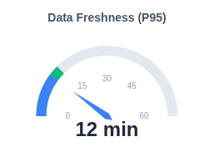
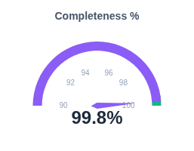
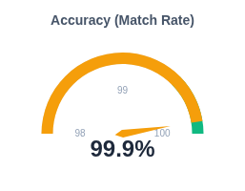



DASHBOARD
Databricks Lakehouse Quality Monitoring
Data Signals
KPIs & SLOs for Lakehouse Quality
Where metrics are sourced
System Tables
DQ INCIDENT RATE
SLA ADHERENCE
MTTR (AVG)
system.information_schema
0.4%
99.9%
18m
-12%
+0.2%
-5m
DLT Event Log
event_log (flow_progress)
TEST COVERAGE
DATA ADOPTION
AUDIT FINDINGS
85%
1.2k
0
Lakehouse Monitoring
+8%
+150
Stable
Profile Metrics & Drifts
Service Level Objectives (SLOs)
Unity Catalog
Lineage & Tags
ALERTING CHANNELS

Slide 8
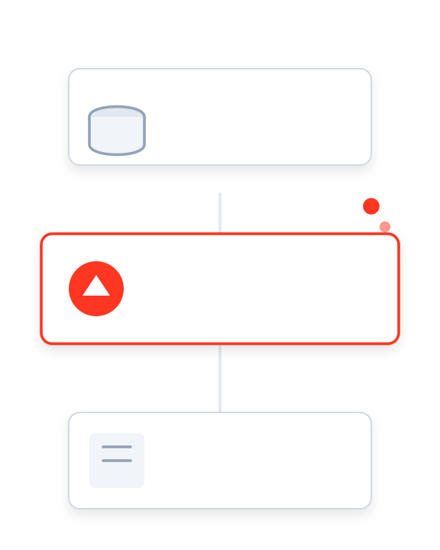
SECTION 02
Architecture — Reference Patterns
Enabling quality-by-design by integrating native Databricks components into a robust engineering framework.
1
PHASE
2
CURRENT
3
PHASE
Strategy
Architecture
Validation
Modular Component Design

Slide 9



















ARCHITECTURE PATTERN
Lakehouse QE Reference Architecture
Validations, Governance & Observability Overlays
Repos & CI/CD
Start: PR Validations & Unit Tests
Databricks Workflows
DATA PIPELINE
OBSERVABILITY
LAKEHOUSE MONITORING
Profile metrics, Drift detection, Quality scorecards
Ingest (Bronze)
Curate (Silver)
Serve (Gold)
SOURCES
Raw / Landing
Clean / Conformed
Aggregated / BI
Files (S3/ADLS)
Auto Loader
DLT / Delta
SQL Warehouse
Databases
Contracts
Schema Drift
Constraints
SLA Monitor
SYSTEM TABLES
Kafka/EventHub
Billing, Audit Logs, Lineage, Query History
PII Scan
Expectations
Delta Share
INCIDENT MGMT
Alerts to PagerDuty / Slack on Validation Failures
Unity Catalog
RBAC & Access
Data Lineage
Tags & Metadata
Row/Col Masking
Governance, Discovery & Lineage Layer
Databricks Component
QE Control / Validation

Slide 10





CI/CD for Data on Databricks
Orchestrating quality gates across Repos, Workflows, and Unity Catalog
1. DEVELOPMENT
2. TEST / STAGING
3. PRODUCTION
Databricks Repos / VS Code
PRE-MERGE GATE
Workflows & DLT (Isolated)
PRE-DEPLOY GATE
Serving & Monitoring
Unit tests (pytest) for logic Repos
Integration job runs Workflows
Blue/Green Deployment
Static analysis (SQLFluff) CI
Data-diff vs. Prod snapshot
SLO Enforcement Monitoring
Schema definition validation UC
Expectation validation DLT
Drift Alerts System Tables
Pre-commit hooks Git
Peer Review + CI Build Pass
PII & Security scan UC
Contract Check + Approval
Auto-Rollback Workflows
Databricks Advantage:
Native integration between Repos (code), Workflows (orchestration), and Unity Catalog (governance) enables automated "Quality as Code" gates at every stage.
Feedback Loop: Lakehouse Monitoring → Repos (Hotfix)
Day 1 — Databricks Quality Engineering Strategy & Architecture
10

Slide 11









Governance & Data Contracts with Unity Catalog
Unifying centralized governance policies with decentralized contract enforcement
Organization & Discovery
Contract Content & Enforcement
3-Level Namespace (Cat.Schema.Table)
Centralized Metastore
Meta-tagging & Search
Data Marketplace / Sharing
Contract Structure (YAML)
Defines schema versions, ownership, SLAs (freshness, accuracy), and privacy policies. Versions are immutable.
Security & Access Control
Fine-grained RBAC (Row/Col)
PII Classification & Masking
Storage-Level Constraints
Attribute-Based Access (ABAC)
Unified Identity Federation
Enforced via Delta Lake CHECK and NOT NULL constraints. Violations block the write transaction immediately.
Observability & Audit
Logical Expectations
Column-level Lineage
System Tables (Audit Logs)
Implemented via DLT Expectations. Allows flexible handling: WARN, DROP, or FAIL pipeline on breach.
Usage & Cost Attribution
Quality Monitor Integration
PR & CI/CD Checks
Static analysis validates contract syntax and schema compatibility (breaking changes) before code merges to main.
Day 1 — Databricks Quality Engineering Strategy & Architecture
Strategy + Architecture + Native Databricks Validation

Slide 12
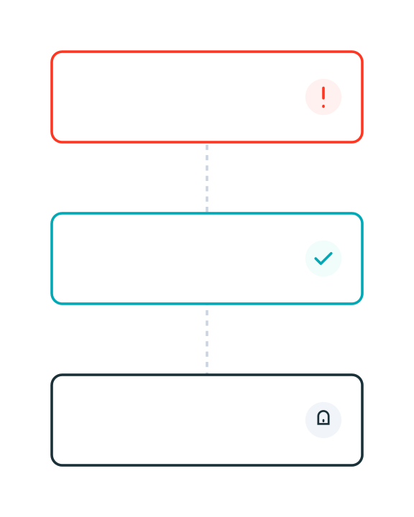



SECTION 03
Native Databricks Validation
Ensuring trust at the source with Delta constraints, DLT expectations, and comprehensive monitoring & alerting.
STORAGE
PIPELINE
OBSERVABILITY
Delta Constraints
DLT Expectations
Monitoring
Native Validation Stack

Slide 13






Delta Lake Constraints & Table Properties
Enforcing quality at the storage layer with ACID guarantees and native controls
NOT NULL & Type Enforcement
Operationalization & Workflow
Fundamental integrity check. Prevents null values in critical columns like Primary Keys, Foreign Keys, or mandatory timestamps.
ALTER TABLE silver_orders ALTER COLUMN order_id SET NOT NULL;
Manage via DDL in PRs
Do not apply constraints manually. Define them in your Infrastructure-as-Code or DDL scripts within the Git repository. CI pipelines execute ALTER TABLE commands during deployment.
CHECK Constraints
Validates row values against boolean expressions. Ideal for domain rules (e.g., price > 0, status codes) directly on the table.
Track via System Tables
Monitor enforcement actions. Query system.quality or the Delta transaction log to see when constraints blocked writes, providing auditability for data rejections.
CONSTRAINT valid_amt CHECK (amount > 0 AND status IN ('OPEN', 'CLOSED'))
Quarantine Patterns
Generated Columns
Constraints block "bad" data by default, causing transaction failure. For resilience, use logic to route invalid rows to a _quarantine table instead of failing the pipeline.
Automatically computes column values based on other columns. Ensures consistency for hash keys, date partitions, or standardizations.
GENERATED ALWAYS AS (cast(event_ts as DATE))
Best Practice
Apply structural constraints (NOT NULL) on Silver tables, but reserve complex business constraints (CHECK) for Gold to allow flexible ingestion.
Day 1 — Databricks Quality Engineering Strategy & Architecture
Confidential & Proprietary

Slide 14



















DAY 1 — DATABRICKS QE STRATEGY
DLT Expectations & Quality Gates
Native Validation Matrix
Bronze (Ingest)
Silver (Curated)
Gold (Trusted)
VALIDATION CATEGORY
Sanity & Schema
Business Rules
Integrity & SLA
Scope & Focus
Technical Sanity
Record Validity
Dataset Trust
File readability, correct format, metadata presence.
Null checks, regex patterns, numeric ranges.
Cross-table referential integrity, unique keys.
What are we validating?
DLT Operator
expect(...)
expect_or_drop(...)
expect_or_fail(...)
WARN: Record the error but allow data to flow.
DROP: Remove invalid rows from the target.
FAIL: Stop the pipeline immediately.
Action on violation
Error Handling
Rescue Clause
Quarantine Table
Incident & Rollback
Auto Loader captures schema mismatch in `_rescued_data`.
Route dropped rows to a side table for review.
Trigger PagerDuty; retain previous state.
Management of bad data
Monitoring
Ingestion Rates
Quality Score
SLO Breaches
Track rows/sec and file arrival latency.
% of rows passing expectations (from Event Log).
Alert on freshness delay or significant drift.
Signals & Alerts
NATIVE TOOLING
DLT Event Log
System Tables
Lakehouse Monitoring
Workflows
Catalog Explorer
14

Slide 15














NATIVE VALIDATION
Module 1 — Strategy & Architecture
Streaming vs. Batch QE Patterns
Comparing validation strategies
Streaming Pipeline
Batch Pipeline
CONTINUOUS / MICRO-BATCH
DISCRETE / SCHEDULED
Input Validation
Pre-flight Checks
Event Source
Schema enforcement on read (Auto Loader)
File completeness & size distribution
File Source
Micro-batch Logic
Logic Validation
Process
Check late data & watermarks
Partition checks & Business Rules
Transform
State Health
Data Diff
Sink (Delta)
Idempotency & Append-only verification
Compare vs Production / Backfill tests
Target Table
SHARED GOVERNANCE FOUNDATION
Data Contracts
Lineage
Time Travel
Alerting
Schema & SLO definitions
Unity Catalog traceability
Delta History & Rollback
PagerDuty / Slack integration
15

Slide 16










HANDS-ON LAB 1
DLT Expectations & Quality Gates
45 Mins
PREREQUISITES
Lab Walkthrough
SUCCESS CRITERIA
Databricks Workspace
Pipeline runs successfully in "Continuous" mode.
Access to create clusters/notebooks
1
Initialize Catalog & Schema
Create a dedicated schema for the lab in Unity Catalog to isolate your quality tests.
Bad data is successfully quarantined to error table.
Unity Catalog
Metastore privileges to create schema
CREATE SCHEMA IF NOT EXISTS lab_qe_v1;
Event log query returns accurate pass/fail counts.
Source Data
Sample JSON dataset mounted/available
2
Ingest with Auto Loader
Compute
Set up a streaming ingestion pipeline using cloud_files to detect new data arrival automatically.
ARTIFACTS
Single-node cluster for dev testing
lab_01_dlt.py
Python Notebook
3
Define DLT Expectations
PRO TIP
Apply quality constraints directly in the pipeline definition. Focus on completeness and domain validity.
sample_data.json
Use the "Development" mode in DLT to keep your cluster running and avoid restart overhead during debugging.
Dataset
Runbook.md
@dlt.expect_or_drop("valid_id", "id IS NOT NULL") @dlt.expect("positive_amt", "amount > 0")
Instructions
Confidential — Training Material
16
4
Configure Quarantine Logic
Route failing records to a separate error table for remediation instead of dropping them entirely.
5
Validate Alerts & Event Log
Query the DLT event log to see how many records passed vs failed expectations.

Slide 17




HANDS-ON LAB 2
Delta Constraints & Workflows Gates
45 Mins
PREREQUISITES
Lab Walkthrough
SUCCESS CRITERIA
Lab 1 Completed
Constraint violations block invalid writes (Transaction aborted).
Uses tables created previously
1
Apply Delta Constraints
Enforce strict data quality rules at the table level using SQL DDL. These constraints prevent bad data from ever being written.
Workflow gate successfully prevents bad promotion.
Databricks Workflows
Access to create job definitions
ALTER TABLE silver_users ADD CONSTRAINT valid_email CHECK (email LIKE '%@%');
Alert received upon validation failure.
SQL Warehouse
Or All-Purpose Cluster
Git Repo (Optional)
2
Create PR with DDL Changes
For versioning DDL scripts
Simulate a production change process. Commit your constraint DDL to a Git branch and open a Pull Request.
ARTIFACTS
constraints.sql
DDL Script
PRO TIP
3
Build "Data Diff" Validation Task
workflow_job.json
Use ALTER TABLE SET TBLPROPERTIES to add descriptive error messages to your constraints for better debugging.
Create a Workflow task that compares the row counts and primary key distributions between Staging and Prod before promotion.
Job Definition
diff_report.html
assert abs(stage_count - prod_count) / prod_count < 0.05, "Drift > 5%"
Validation Output
Confidential — Training Material
17
4
Configure Rollback Path
Add a "If/Else" condition in Workflows. If the validation task fails, trigger a rollback script or send a Slack alert.
5
Run End-to-End Workflow
Trigger the job manually. Verify that inserting invalid data causes the constraint to fire and the job to fail safely.

Slide 18





DAY 1 WRAP-UP
|
Session Checkpoint
Day 1 Checkpoint & Next Steps
Databricks Quality Engineering Strategy
REVIEW
REVIEW
IMMEDIATE NEXT
What We Aligned
What We Built
Module 1 Kickoff
Strategy Pillars: Confirmed Trust, Velocity, and Compliance as core tenets tailored to Lakehouse.
Reference Architecture: Mapped QE controls to Unity Catalog & DLT.
Start Module 1 Blueprint
Deep dive into Bronze/Silver/Gold controls (Slides 19–30).
Native Validation: Deployed "Quarantine" patterns and Delta constraints.
Operating Model: Ratified RACI for Platform vs. Domain ownership.
Finalize RFP Assets: Complete scoring rubric & value narrative.
Lab Artifacts: Functional pipeline with automated expectation suites.
Success Metrics: Defined baseline for Incident Rate, SLA Adherence, and MTTR.
Pilot Selection: Identify domain for initial rollout.
Launch Readiness Status
CHECKLIST
GOVERNANCE
METRICS
TOOLING
OBSERVABILITY
RACI Aligned
SLOs Defined
Templates Ready
Alerts Pending
© 2026 Enterprise Quality Engineering
Page 18

Slide 19




GENSPARK
2-HOUR TRAINING MODULE
Module 1 — Enterprise Lakehouse Quality Engineering Blueprint
QA Strategy for Bronze → Silver → Gold layers with concrete controls
Quality Engineering in Data Mesh & Domain-driven Pipelines
How QE contributes to Deal Wins & RFP Scoring
Presented by: [Presenter Name]
January 2026
Enterprise Quality Practice

Slide 20





Agenda & Outcomes
Module 1 — Enterprise Lakehouse Quality Engineering Blueprint
Duration: 2 Hours
40 MINS
40 MINS
30 MINS
01
02
03
QA Strategy
QE in Data Mesh
Commercial Impact
Bronze → Silver → Gold
Domain-driven Pipelines
Deal Wins & RFP Scoring
Deep dive into layered quality gates. How to de-risk ingestion, validation, and serving layers with specific controls.
Federated quality ownership. Defining data contracts, SLOs, and CI/CD gates for decentralized teams.
Translating technical quality into business value. How QE maturity improves win rates and RFP scores.
Standardized controls & test types per layer
Clear operating model for data domains
RFP scoring rubric & value narrative
KEY TAKEAWAYS
Learning Outcomes
CI/CD quality gate definitions
Concrete KPI set for measuring QE success
Confidential — Internal Training Material
Page 2

Slide 21
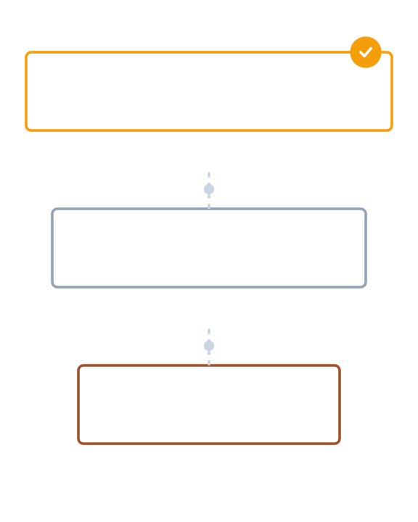
SECTION 01
QA Strategy: Bronze → Silver → Gold
How layered quality gates de-risk data ingestion, curation, and serving through a progressive maturity model.
1
LAYER 1
2
LAYER 2
3
LAYER 3
Ingestion
Curation
Serving
Quality Gate Architecture

Slide 22








Lakehouse Quality Framework
Progressive quality controls from ingestion to consumption to ensure trust at scale
Bronze Layer
Silver Layer
Gold Layer
Raw Ingestion & Landing
Cleaned & Conformed
Aggregated & Trusted
KEY CONTROLS
KEY CONTROLS
KEY CONTROLS
Land data "as-is" (immutable)
Strict schema enforcement
Business logic reconciliation
Schema capture & versioning
Null / Duplicate / Range checks
Bias & anomaly detection
PII tagging & classification
Referential integrity logic
Row-level access policies
File checksum validation
SCD Type 2 history tracking
Cross-source validation
Owner
Platform Eng
Owner
Domain Eng / QE
Owner
Product / Analytics QE
SLO Focus
Freshness / Availability
SLO Focus
Completeness / Accuracy
SLO Focus
Usability / Consistency
Primary Check
Volume & Arrival
Primary Check
Data Constraints
Primary Check
Business Rules
2026 Enterprise Quality Engineering
Module 1: Enterprise Lakehouse Quality Engineering Blueprint

Slide 23




















MODULE 1 — QUALITY ENGINEERING BLUEPRINT
Controls & Test Types by Layer
Comparison Matrix
Bronze (Raw)
Silver (Validated)
Gold (Trusted)
CONTROL CATEGORY
Ingestion & Landing
Cleaning & Integration
Aggregation & Serving
Schema & Structure
Schema Capture
Strict Enforcement
Frozen Contracts
Drift detection & enforcement
Detect new columns; allow evolution.
Fail on schema mismatch; reject bad types.
Zero tolerance for breaking changes.
Data Quality
Freshness & Volume
Nulls & Duplicates
Business Logic
File arrival SLAs; Row count ±10% vs source.
Drop/quarantine invalid PKs; Range checks.
KPI reconciliation; Cross-system alignment.
Accuracy, Completeness, Consistency
Lineage & Ops
File Checksums
Transformation Logic
Audit Trail
Traceability and operational health
Verify exact replica of source.
Job-level lineage; Error handling logs.
Full provenance; Reproducible metrics.
Privacy & Access
PII Tagging
Masking & Tokenization
RBAC & Row Security
Compliance and PII protection
Identify sensitive columns on ingestion.
Apply dynamic masking policies.
Fine-grained access control lists.
TOOLING ECOSYSTEM
Delta Constraints
Great Expectations / Deequ
dbt tests
Monte Carlo / Datadog
Airflow SLA Checks
5

Slide 24







Example Checks & Automation Patterns
Detailed breakdown of quality controls by layer vs. automation strategies
Bronze (Raw Ingestion)
Automation & CI/CD Patterns
Row counts vs source (±2% tolerance)
File checksum validation
Arrival freshness < 15 mins
PII column detection tagging
Data Contracts as Code
Define expectations in YAML/JSON at source. Ingestion pipelines auto-generate validation logic based on the contract schema.
Silver (Validated & Cleaned)
NOT NULL on business keys
Duplicate suppression (PK unique)
Valid domain sets (Ref Tables)
SCD Type-2 history continuity
PR-Validated Expectations
Run dbt test or Great Expectations suites on a staging clone during Pull Request. Block merge if new logic breaks existing constraints.
Gold (Aggregated & Trusted)
Data-Diff on Promote
Totals reconciliation vs GL
Metric drift vs 30-day baseline
Semantic consistency across marts
Strict BI contract tests
Compare row-level output of new code vs. production code on a sample dataset to catch unintended regressions before full deployment.
Canary Releases & Rollback
Deploy to a "canary" partition first. If error rate or freshness SLOs are breached, system automatically reverts to the previous version.
Module 1 — Enterprise Lakehouse Quality Engineering Blueprint
Confidential & Proprietary

Slide 25
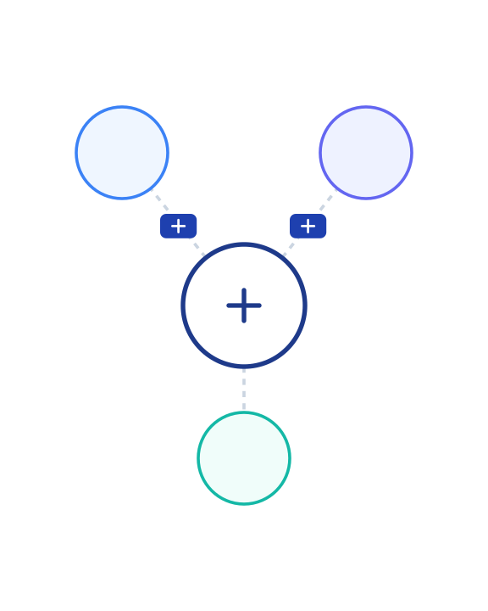
SECTION 02
QE in Data Mesh & Domain-driven Pipelines
Establishing the operating model for federated domains through clear ownership, data contracts, and automated platform guardrails.
Federated Mesh Architecture
OPERATING MODEL
INTERFACE
PLATFORM
1
2
Contracts
3
Guardrails
Ownership

Slide 26




Ownership & Data Contracts
Defining roles, responsibilities, and the structure of data contracts in a mesh architecture
Domain Product Owner
Data Contract Structure
Accountable for data product value and quality. Defines "what good looks like" from a business perspective and approves SLA breaches.
CORE SPECIFICATIONS
Schema Versioning: Explicit field types, nullability, and version (e.g., v1.2.0).
Data Engineer
Builds pipelines to meet contract specs. Implements transform logic, enforces schema, and ensures technical stability of ingestion.
SLOs (Service Level Obj): Freshness (e.g., <30m), Completeness (>99%), Accuracy (±1%).
Semantics: Field descriptions, business glossary links, and value distribution expectations.
QE Owner / Lead
Governance: PII tags, data retention policies, and authorized consumer roles.
Architects the test strategy. Defines validation rules, sets up CI/CD gates, and monitors drift/quality metrics across the lifecycle.
Change Management Policy
Data Steward
Backward compatibility required for minor updates.
Ensures compliance with governance standards (PII, retention). audits access controls and metadata completeness.
Breaking changes require a major version bump & consumer approval workflow.
Automated notifications sent 7 days prior to deprecation.
Module 1 — Enterprise Lakehouse Quality Engineering Blueprint
Confidential & Proprietary

Slide 27











MODULE 1 — QUALITY ENGINEERING BLUEPRINT
Template: canvas_one_pager
Domain Data Product Canvas (Quality-First)
Proprietary & Confidential
M1
Use Cases & Value
Inputs & Sources
Quality Contract
Primary Goal: Provide clean customer 360 view for marketing personalization.
CRM (Salesforce)
Clickstream (Kafka)
Support (Zendesk)
Guaranteed Service Levels (SLOs)
TARGET OUTCOMES
DEPENDENCIES
Daily batch dump from CRM (02:00 UTC)
FRESHNESS
Reduce churn by 5% via targeted offers.
Real-time events stream topic: `user_events`
T-1 Hour
Increase upsell conversion by 10%.
ROI HYPOTHESIS
Data available by 8:00 AM daily
$2M annual revenue lift based on pilot data.
COMPLETENESS
99.95%
Transformation Logic
Outputs & Interfaces
Non-null essential keys
Key Logic: Identity resolution across email/device_id.
Primary Interface: Delta Table `gold.cust_360`
ACCURACY
PROCESSING STEPS
Secondary Interface: REST API for real-time scoring.
+/- 0.5%
Ingest raw Bronze (append-only)
SCHEMA
Deduplicate & clean (Silver)
Variance vs Source System
cust_id (PK), segment, LTV, last_login
Aggregate session metrics (Gold)
VALIDITY
Current Health
HEALTHY
0 Critical
Last validated: Today, 09:15 AM
Consumers & Access
Governance & Owners
Blocking errors allowed
Downstream Teams: Marketing Ops, Data Science (Churn Model).
Product Owner
Data Steward
© 2026 Enterprise Quality Engineering. All rights reserved.
Sarah J.
Mike L.
9
ACCESS POLICIES
Classification
Retention
CONFIDENTIAL
3 Years
PII Masking applied for DS team.
Read-only access via `marketing_reader` role.

Slide 28





CI/CD for Data Pipelines with QE Gates
Robust automation ensuring quality from local development to production serving
1. DEVELOPMENT
2. INTEGRATION / TEST
3. PRODUCTION
Local dbt/spark unit tests
Pull Request Gate
Full integration tests
Release Gate
Canary Deployment
Static code analysis (SQLLint)
Data-diff vs. Golden Set
Live SLO monitoring
Schema contract validation
Performance/Volume tests
Drift detection alerts
Sample data profile checks
Peer review + CI Build Pass
Security & PII scanning
Sign-off + Contract Compliance
Automated rollback logic
Key Benefit:
Shifting checks left (to Dev/Test) reduces production incidents by ~40-60% and accelerates hotfix cycles.
Continuous Feedback & Observability
Module 1 — Enterprise Lakehouse Quality Engineering Blueprint
10

Slide 29
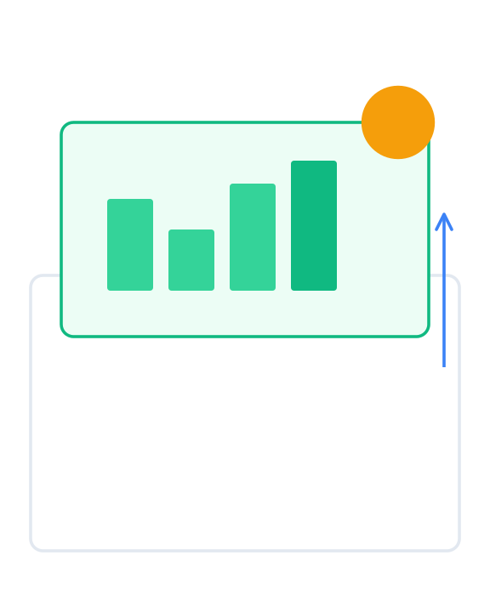



SECTION 03
QE Impact: Deal Wins & RFP Scoring
Positioning Quality Engineering as a strategic differentiator to reduce risk, assure compliance, and accelerate value delivery.
IMPACT 1
IMPACT 2
IMPACT 3
Risk Reduction
Compliance
Faster Value
Competitive Advantage Model

Slide 30


Value Narrative & RFP Scoring
Translating quality engineering capabilities into business value and deal assurance
Sample RFP Scoring Rubric Impact
Expected Business Value
Evaluation Criteria
QE Contribution Strategy
Points
40-60%
25-35%
Reduction in Data Quality Incidents
Faster Time-to-Insight (Cycle Time)
Approach & Architecture
Layered gates (Bronze/Silver/Gold) show structured risk mitigation
30
20-30%
100%
Technical Scalability
Automated Data Mesh controls demonstrate ability to scale domains
25
Lower L3 Engineering Support Cost
Compliance Audit Traceability
Quality & Testing
Comprehensive automation, contracts, and observability SLOs
25
KEY PERFORMANCE INDICATORS (KPIS)
DQ Incident Rate
SLA Adherence %
Commercials / TCO
Reduced support costs and rework lowers long-term TCO
20
Mean Time to Recovery
Test Coverage %
Data Product Adoption
Audit Findings Count
QE Maturity Ladder Positioning
1
2
3
4
Ad hoc
Managed
Automated
Predictive
High RFP scores typically require demonstrating Level 3+ capabilities
Module 1 — Enterprise Lakehouse Quality Engineering Blueprint
Confidential & Proprietary

Slide 31

GENSPARK
MODULE 2
Databricks Native Data Validation Framework
Delta Expectations & DLT Validation
SLA-driven Workflows & Breakpoints
2.5 hours | Short demo included
Presented by: [Presenter Name]
[Date: MM/DD/YYYY]
[Team/BU]

Slide 32




Module 2 Agenda & Outcomes
Databricks Native Data Validation Framework
Duration: 2.5 Hours
45 min
45 min
01
02
Delta Expectations & DLT Validation
SLA-driven Workflows & Breakpoints
Deep dive into expectation types, validation actions (fail/drop/quarantine), and event log monitoring.
Designing quality gates, implementing canary releases, and configuring automated rollback patterns.
30 min
30 min
03
04
Cost Savings Analysis
Live Demo & Q&A
Comparing TCO of native validation vs. additional 3rd party tools. ROI model and efficiency gains.
Interactive session: Building a validation pipeline, triggering alerts, and Q&A.
TARGET OUTCOMES
Implement DLT expectations effectively
Design SLA-driven gates in Workflows
Module 2 Goals
Quantify TCO savings (Native vs Tools)
Run a working validation demo
Confidential — Internal Training Material
Page 32

Slide 33
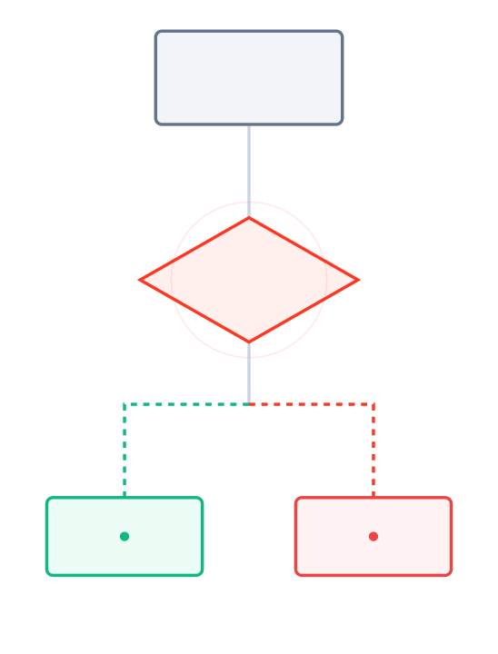



MODULE 02 | SECTION 01
Delta Expectations & DLT Validation
Implementing native quality controls using DLT expectations, defining enforcement actions (Fail, Drop, Quarantine), and unlocking observability via the Event Log.
CONCEPT 1
CONCEPT 2
CONCEPT 3
Native Validation Logic Flow
Types
Actions
Insights
Validity, Uniqueness, Referential Integrity
Warn, Drop, Fail, or Quarantine
Event Logs & System Tables

Slide 34




MODULE 2 — DATABRICKS NATIVE VALIDATION
DLT Expectations — Types x Layers
Validation Matrix
Bronze (Ingest)
Silver (Curated)
Gold (Trusted)
EXPECTATION TYPE
Sanity Checks | Action: WARN/QUARANTINE
Business Logic | Action: DROP/QUARANTINE
Strict SLAs | Action: FAIL
Completeness
Sanity check source IDs
Mandatory business keys
Strict reporting fields
Required fields & null checks
expect("id IS NOT NULL")
expect_or_drop("order_id IS NOT NULL")
expect_or_fail("revenue IS NOT NULL")
Validity / Domain
Data types & formats
Allowed value sets
Strict range bounds
Ranges, formats, enums
expect("ts > '2020-01-01'")
expect_or_drop("status IN ('OPEN', 'CLOSED')")
expect_or_fail("pct BETWEEN 0 AND 100")
Uniqueness
File/Row checksums
Deduplication logic
Primary Key Constraint
Duplicate detection
Usually handled by Auto Loader
APPLY CHANGES INTO ... KEYS (id)
CONSTRAINT pk PRIMARY KEY (id)
Referential Integrity
Rarely enforced at ingest
Lookup validation
Strict Foreign Keys
Cross-table validation
expect("cust_id IN (SELECT id FROM cust)")
CONSTRAINT fk FOREIGN KEY (c_id) REF...
Business Rules
N/A
Discount logic validity
GL Reconciliation
Complex logic & derivations
expect("discount < total_amount")
expect_or_fail("sum(amt) == sum(gl_amt)")
OPERATOR KEY
expect (Warn)
expect_or_drop (Drop)
expect_or_fail (Fail)
Quarantine Pattern Recommended
34

Slide 35













Signals & Monitoring for DLT Validation
Key quality metrics to capture and where to observe them in the Databricks ecosystem
Expectation Outcomes
Observation & Tools
Track the raw count of passed vs. failed records per micro-batch. Essential for identifying immediate quality breaches and trend regression.
DLT Event Log
Raw JSON events
Quarantine Volumes
Lakehouse Monitoring
Auto-dashboards
Monitor the "Quarantine" or "Drop" rate. A spike in quarantined rows indicates upstream schema drift or corrupted source data ingestion.
System Tables
SQL queryable metadata
Rule-Level Failure Trends
Unity Catalog Lineage
Impact analysis
Isolate which specific rule (e.g., "valid_customer_id") is failing most often to pinpoint root causes in source systems or transformation logic.
ALERTING PATTERNS
Email Reports
Slack / Teams
Webhooks
Data Drift & Freshness
PagerDuty
Detect shifts in column value distributions (e.g., null % increase) and track SLIs for data arrival latency against defined SLAs.
Module 2 — Databricks Native Data Validation Framework
Confidential & Proprietary

Slide 36




LIVE DEMO
DLT Expectations in Action
20 Mins
PREREQUISITES
Demo Walkthrough
SUCCESS CRITERIA
Workspace Repo
Bad rows successfully quarantined.
Cloned demo repository
1
Define Expectations
Sample Dataset
Add completeness and domain validity checks to the pipeline code.
Expectations visible in UI.
Mounted in DBFS/Volumes
Alert triggered correctly.
Permissions
@dlt.expect("valid_tx", "amount > 0")
Create/Run DLT Pipelines
Pipeline status remains Green.
2
Configure Quarantine Target
Set up the target_schema for error records and run the initial pipeline.
ARTIFACTS
demo_script.py
3
Inject Bad Data & Re-run
Notebook
Introduce invalid records (null keys, negative amounts) into the source and trigger an update to observe handling.
DEMO TIP
dlt_config.json
Keep the "Flow" tab open in DLT UI to show real-time record processing counts and quarantine routing visually.
Settings
Injecting 50 failing records...
screenshots/
Reference
4
Review Metrics & Dashboard
Confidential — Training Material
36
Analyze the DLT event log metrics and check the Lakehouse Monitoring dashboard for quality trends.
5
Trigger Alert & Drill Down
Show the fired alert notification and drill down into the error table to inspect quarantined rows.

Slide 37
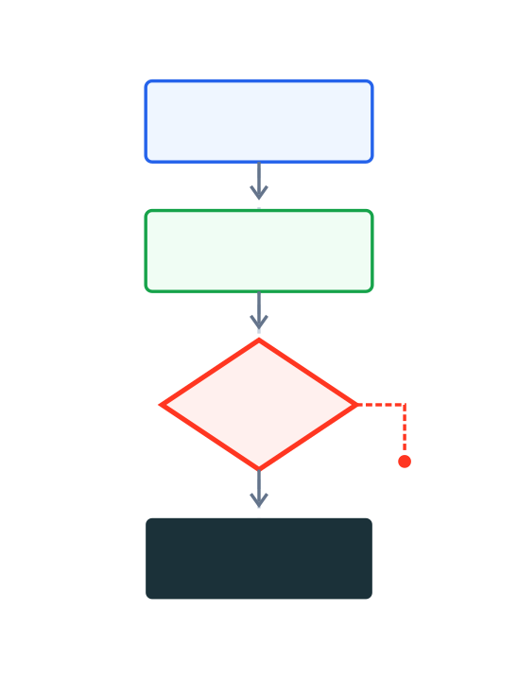


SECTION 02
SLA-driven Workflows & Breakpoints
Designing intelligent quality gates tied to Service Level Objectives (SLOs) with automated canary releases, rollback capabilities, and real-time alerting.
Automated Quality Pipeline
CONTROL
SAFETY
SIGNAL
SLO Gates
Rollback
Alerting
Threshold Enforcement
Canary & Recovery
Real-time Obs.

Slide 38







Workflows with Quality Gates & SLO Enforcement
Designing conditional pipelines with automated validation, thresholds, and incident routing
1. VALIDATE
2. TRANSFORM
3. RECONCILE
4. PUBLISH
Ingest & Schema
INGEST GATE
Business Logic
QUALITY GATE
Aggregates & Trends
SLO GATE
Serving Layer
Schema drift check Auto Loader
Completeness (Nulls) DLT
Source-to-Target totals
Update Views/MVs UC
Contract validation JSON
Domain rules (Ranges)
Variance vs 30-day avg
Grant Access (ACLs)
File format integrity
Referential checks
Cross-table sanity
Update Lineage Meta
Sample row checks Spark
Stop if Schema Mismatch
Dedup logic Watermark
Stop if Error % > Threshold
Gold data-diff DBSQL
Breach if Freshness > SLA
Canary API Check
SLA-Driven Logic:
IF GATES FAIL: Incident Routing
Workflows conditional tasks utilize Job Task Values to check failure ratios. If validation passes, the pipeline proceeds; otherwise, it branches to an alert task.
Auto-Quarantine
PagerDuty Alert (P2)
Rollback & Notify (P1)
Module 2 — Databricks Native Data Validation Framework
38

Slide 39
















MODULE 2 — NATIVE VALIDATION FRAMEWORK
Workflows & Breakpoints
Breakpoints: Canary & Rollback Patterns
Safe deployment strategies
Streaming: Canary / Shadow
Batch: Promote / Rollback
REAL-TIME SAFETY
SCHEDULED GATES
Shadow Mode
Data-Diff Check
Deploy New Ver.
Dual-write to temp location (no consumer impact)
Compare partition stats vs last successful run
Stage Run
Compare Metrics
Gate Decision
Canary Stream
Validate error ratio & latency vs production
Completeness > 99.9%? Freshness within SLA?
SLO Validation
Breakpoint
On Failure
Switch Traffic
If error > 1%: Halt. If < 1%: Update checkpoint.
Restore previous table version (Time Travel)
Auto-Rollback
SHARED CONTROLS & GOVERNANCE
Contracts
Lineage
Alerting
Audit Trail
Versioned schema & expectations
Impact analysis for rollbacks
PagerDuty routing on gate failure
Log all promotions & rejections
39

Slide 40
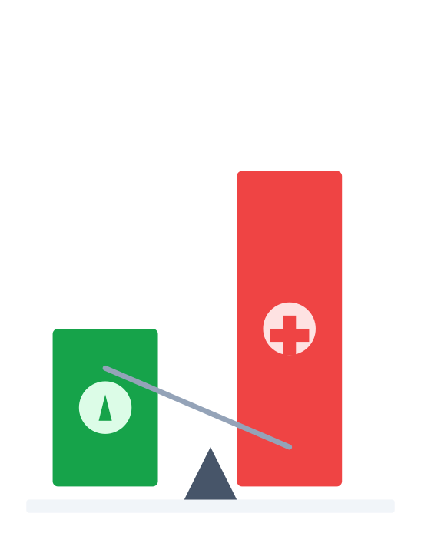



SECTION 03
Cost Savings — Native vs Additional Tools
Analyzing Total Cost of Ownership (TCO), eliminating tool duplication, and achieving operational simplification through native validation.
Cost Efficiency Model
DRIVER 1
DRIVER 2
DRIVER 3
TCO
Duplication
Simplicity
Lower License Fees
Eliminate Redundancy
Unified Operations

Slide 41
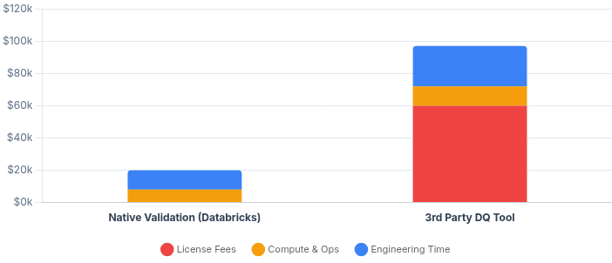


MODULE 2 — NATIVE VALIDATION
TCO Analysis
Cost Comparison: Native vs. Add-on Tools
Total Cost of Ownership Model
Native Stack
Annual TCO Projection
79% Savings
DATABRICKS NATIVE
Comparing annual spend for a medium-sized data team (5 engineers, 10 pipelines)
No Licensing Fees: Included in workspace DBU pricing.
TOTAL ANNUAL COST
$20k
Unified Ops: Reuse existing observability & IAM.
Native Validation
Performance: Zero data movement overhead.
$97k
3rd Party Tool
3rd Party Tool
SEPARATE SAAS
High License Costs: Per-seat or volume-based pricing.
Complex Ops: Separate access controls & agents.
ROI Levers & Assumptions
Page 41
Assumes 10 pipelines, daily runs. Native: Uses DLT core hours + minor engineering overhead for config. 3rd Party: Includes base platform fee ($40k), connector fees ($20k), plus separate compute costs for scanning data and higher engineering maintenance (context switching).
Duplication: Redundant compute for validation.

Slide 42


GENSPARK
2-HOUR TRAINING MODULE
Module 3 — Data Contracts, Governance & Observability
Unity Catalog: Schema Enforcement & Access Controls
Lineage-based Compliance for Business KPIs
Operational Data Quality Scorecards
2 Hours | Strategy & Implementation
Presented by: [Name, Title]
Date: [MM/DD/YYYY] | [Team/BU]

Slide 43





Module 3 Agenda & Outcomes
Data Contracts, Governance & Observability
2 Hours
01
00:00 – 00:35
02
00:35 – 01:00
03
01:00 – 01:30
Unity Catalog Controls
Data Contracts Lifecycle
Lineage-based Compliance
Schema enforcement strategies, Access Control Lists (ACLs), and tagging policies.
Defining contracts in code and enforcement points across CI/CD and runtime.
Tracing Business KPIs back to source data for audit readiness and impact analysis.
04
01:30 – 01:50
05
01:50 – 02:00
Operational Scorecards
Q&A & Wrap-up
Module Complete
Building Data Quality dashboards with RAG status, SLIs, and trend metrics.
Reviewing key module takeaways, open discussion, and next steps.
TARGET OUTCOMES
Define & enforce data contracts
Trace KPI lineage for compliance
Module 3 Goals
Apply Unity Catalog access controls
Stand up DQ scorecard with SLOs
Confidential — Internal Training Material
Page 43

Slide 44




SECTION 01
Unity Catalog — Schema Enforcement & Access Controls
Establishing the foundation of governance through strict contract enforcement, schema validation, and fine-grained, compliant access policies.
Governance & Enforcement Model
CONCEPT 1
CONCEPT 2
CONCEPT 3
Schema
Access
Compliance
Typing & Constraints
RBAC & Filtering
Audit & Lineage

Slide 45








Unity Catalog Controls — Schema & Access
Enforcing strict data contracts and compliant access patterns across the Lakehouse
Schema Enforcement
Access Controls
Strong Typing & Constraints
Enforce data types, NOT NULL constraints, and Delta CHECK constraints to reject invalid records at write time.
Fine-Grained RBAC
Standard SQL
on Catalogs, Schemas, Tables, Views, and Functions.
/
GRANT
REVOKE
Schema Evolution & Versions
Row & Column Policies
Manage schema changes via versioned contracts. PR-based reviews for DDL ensures backward compatibility.
Dynamic masking based on user groups and row-level filtering to segregate tenants/regions.
Attribute-Based Tags
Audit & Lineage
System Tables capture every access event. Lineage Explorer traces permission flow and impact.
Apply PII and sensitivity tags at the column level. These tags drive downstream policy attachment automatically.
ENFORCEMENT MECHANISMS
SQL ANSI Mode
Unity Catalog Service
Dynamic Views
Delta Constraints
Module 3 — Data Contracts, Governance & Observability
Confidential & Proprietary

Slide 46







MODULE 3 — DATA CONTRACTS & GOVERNANCE
Governance Matrix — Objects x Policies
Unity Catalog Controls
Owner
Privileges
Tags / PII
Row/Col Policy
Audit / Lineage
UC OBJECT
User / Group
RBAC (Grant/Revoke)
Classification
Fine-grained Access
System Tables
Catalog
USE / CREATE
—
Schema
USE / CREATE / SELECT
—
Table / View
Primary Data Asset
SELECT / MODIFY
Column Tags
Row Filters & Masks
Column Lineage
Function
EXECUTE
Used in Policy
Volume
—
Unstructured
READ / WRITE
PRIMARY CONTROLS
EVIDENCE & AUDIT
POLICY STRATEGY
Use Unity Catalog for RBAC & Attribute Tags
System Tables (audit_logs, lineage)
Combine Row Filters and Column Masks with dynamic functions (e.g., is_member()) to enforce access without creating view proliferation.
Use Delta Table Properties for Constraints
Lineage Explorer (Column-level impact)
46

Slide 47
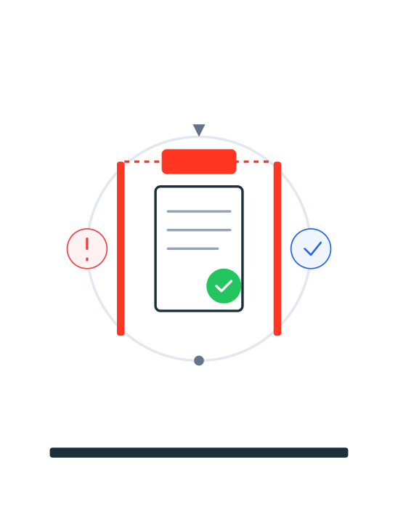






SECTION 02
Data Contracts Lifecycle & Enforcement Points
A holistic approach to managing data quality through the five critical stages: Define → Validate → Enforce → Observe → Evolve.
Continuous Enforcement Loop
01
02
03
04
05
Define
Validate
Enforce
Observe
Evolve

Slide 48





Contracts Lifecycle — Where Enforcement Happens
Orchestrating quality gates from schema definition to runtime enforcement and evolution
1. DEFINE & VALIDATE
2. ENFORCE
3. OBSERVE & EVOLVE
Repos / PR Checks
PRE-MERGE GATE
Runtime (DLT/Delta/UC)
RUNTIME GATE
Monitoring & Lifecycle
Define Schema, SLOs & Null% YAML
Apply Constraints (NOT NULL) Delta
Track SLI Trends Sys Tables
Run Contract Linters CI
Execute Expectations DLT
Alert on SLA Breaches Webhook
Static Compatibility Checks
Enforce Row/Col Policies UC
Deprecation Policy Notices
Validate against Sample Data
Contract Valid & Approved
Block Bad Records (Drop/Fail)
Breach Threshold < Limit
Schema Evolution & Versioning
Contract-First Architecture:
Contracts are defined as code in Repos, enforced natively by Delta & DLT at runtime, and governed by Unity Catalog, ensuring end-to-end traceability.
Feedback Loop: Contract Evolution (Version Bump) → Repos
Module 3 — Data Contracts, Governance & Observability
48

Slide 49
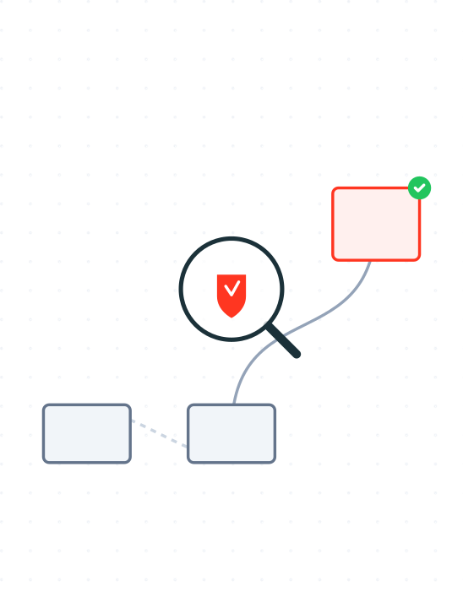


SECTION 03
Lineage-based Compliance for KPIs
Leveraging Unity Catalog to map KPI definitions to upstream data controls, ensuring audit-ready evidence and precise impact analysis.
POINT 1
POINT 2
POINT 3
Audit-Ready Compliance Flow
Traceability
Evidence
Analysis
Source to Metric
Audit-Ready Logs
Upstream Risk

Slide 50













COMPLIANCE & GOVERNANCE
Lineage-to-KPI Impact Path (Example)
Tracing Audit Evidence from Source to Executive Dashboard
Traceability Chain
Versioned Contracts → Validated Pipeline → Certified Metric
Target KPI:
Net Revenue Retention (NRR)
GOVERNED PIPELINE
COMPLIANCE EVIDENCE
UC Lineage Graph
SOURCES
Full impact analysis path available for audit. Proves data provenance.
BRONZE
SILVER
GOLD
BI REPORT
Salesforce
Raw Ingest
Clean / Valid
KPI Mart
Executive Dash
CRM Data
Ingest/Load
Curate/DLT
Aggregate
PowerBI/Tableau
Rule Execution Logs
NetSuite
DLT event logs showing 100% pass rate for "Revenue" validation rules.
Billing Data
Schema Ver.
Expectations
SLA: Acc
Certified
Owner: Plat
Owner: Domain
Owner: Product
Access: Exec
Contract v1.2
KPI Definition
Semantic logic version controlled in Git. Signed off by Finance.
Unity Catalog Foundation
End-to-End Lineage
Time-Travel Audit
Fine-grained Access
The single source of truth for Permissions & Audit

Slide 51





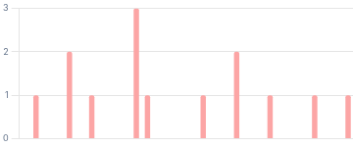
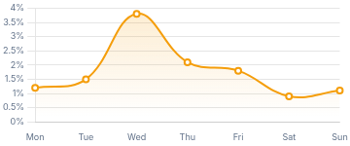

Operational Data Quality Scorecard
Apply
Real-time governance and SLO observability dashboard
INCIDENT RATE (7D)
MTTR
SLA ADHERENCE
TEST COVERAGE
2.4% 0.8%
45m 12m
99.2% 0.3%
84% 5%
Data Product SLO Status
View All Products
SLA Breaches (30d)
14
Volume by day
Total Events
DATA PRODUCT
OWNER
FRESHNESS
COMPLETENESS
ACCURACY
AVAILABILITY
Sales_360
Comm. Team
Pass
Pass
Pass
99.9%
Customer_360
Growth
Warn
Pass
Pass
99.8%
Supply_Chain
Ops
Pass
Fail
Warn
99.5%
Fin_Forecast
Finance
Pass
Pass
Pass
100%
Camp_Attribution
Marketing
Fail
Warn
Pass
98.2%
DQ Failure Rate (7d)
2.1%
% of rows quarantined
Avg Rate
Web_Telemetry
Product
Pass
Pass
Pass
99.9%
Source: Unity Catalog System Tables + DLT Event Logs
Data refreshed: Just now

Slide 52




Wrap-up — What Good Looks Like
Summary of Module 3: Capabilities Achieved & Immediate Next Steps
Enforced Contracts
Next Steps / Checklist
Data contracts are now actively enforced via Unity Catalog policies, Delta constraints, and DLT expectations across layers.
Enable org-wide policy templates in UC
KPI Lineage Compliance
Publish DQ scorecard to executive stakeholders
Full lineage established from raw source to business KPI, providing instant impact analysis and audit-ready compliance evidence.
Bake contract validation into PR quality gates
Operational DQ Scorecards
Configure automated evidence export for audit
Deployed centralized scorecards with clear SLIs/SLOs, RAG status visibility, and automated alerting for domain teams.
MODULE 3 STATUS
Governance Setup
Observability
Audit Ready
Module 3 — Data Contracts, Governance & Observability
Confidential & Proprietary

Slide 53
GENSPARK
4-HOUR TRAINING MODULE
Day 2 — AI-driven QE + Business Narrative & RFP Practicum
4 Hours | Module 5 (AI & Agents for Data Quality) + RFP Practicum
AI-Driven Quality: Agents, Vector Search RAG & Auto-Rules
Outcomes: AI Agent Workflow • Value Story Narrative • RFP Scoring
Presented by: [Name, Title]
Date: [MM/DD/YYYY]
[Team/BU]

Slide 54






Day 2 Agenda & Outcomes
AI-driven QE + Business Narrative & RFP Practicum (4 Hours)
4 Hours
01
00:00 – 00:10
02
00:10 – 01:40
03
01:40 – 01:50
Kickoff & Objectives
Module 5: AI Agents
Short Break
Overview of AI-driven Quality Engineering goals and RFP practicum structure.
AI Agents for Drift/RCA, Lightweight RAG with Vector Search, and Auto-Rule Generation.
Transition from technical AI deep-dive to business strategy session.
04
01:50 – 02:50
05
02:50 – 03:50
06
03:50 – 04:00
Value Narrative
RFP Practicum
Wrap-up
Crafting the value story (Risk, Velocity, Cost) and identifying evidence artifacts.
Hands-on scoring rubric workshop and mini case exercise.
Review artifacts, final Q&A, and AI pilot readiness checklist.
TARGET OUTCOMES
Deploy AI agent workflow
Design Vector Search RAG
Define auto-rule approach
Day 2 Goals
Build value narrative
Practice RFP scoring
Pilot AI readiness confirmed
Confidential — Internal Training Material
Page 54

Slide 55
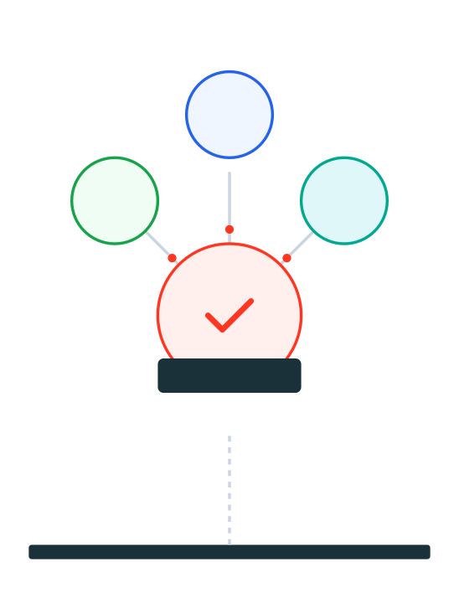



MODULE 05
AI & Agents for Data Quality
Harnessing GenAI for intelligent drift detection, automated root-cause analysis, and metadata-driven validation rules.
TOPIC 1
TOPIC 2
TOPIC 3
AI-Driven Quality Engine
AI Agents
Vector Search
Generative QE
Drift & RCA
Lightweight RAG
Auto-Rules

Slide 56










AI Agent Use Cases for QE
Applying AI Agents to automate detection, analysis, and quality operations
Drift Detection & Anomaly Triage
Benefits & Impact
Automated analysis of distribution shifts and proactive anomaly classification to reduce noise.
Faster MTTR (Mean Time To Resolution)
Root Cause Analysis (RCA)
Cross-referencing lineage, logs, and code changes to pinpoint failure origins instantly.
Improved Test Coverage & Accuracy
Reduced Manual Toil & Ops Cost
Metadata & Contract Search
Natural language retrieval of schema definitions, contracts, and documentation via agents.
Policy Assistant
Automated identification of PII/PHI and compliance suggestions during development.
REQUIRED GUARDRAILS
Human-in-the-Loop
Audit Trails
Least Privilege
Test Summarization
Prompt Governance
Generating concise, human-readable summaries of test results and incident notes.
Day 2 — AI-driven QE + Business Narrative & RFP Practicum
Confidential & Proprietary

Slide 57




















AI Agent Workflow — Components & Signals
MODULE 5
Orchestrating autonomous quality engineering with human-in-the-loop safeguards
1. SIGNALS / CONTEXT
2. AGENT ORCHESTRATOR
3. TOOL REGISTRY
4. ACTIONS
Data & Observability Feeds
Decision & Reasoning Engine
Capabilities
Outcomes
Human-in-Loop
Monitoring SLIs
Vector Search (RAG)
Draft Rule
Freshness, Anomaly
New Expectation
Safety & Policy
Guardrails & Permissions
SQL / Unity Catalog
Open PR
DLT Event Log
Code Change
Expectation Results
Tool Router
Git / PR Bot
Context Retrieval & Planning
Annotate RCA
Incident Context
UC Lineage
Workflow Runner
Upstream Dependencies
Route Alert
Approval Queue
To Data Owner
Wait for Sign-off
System Tables
Audit & Query Hist
Governance & Audit Layer
Audit Trail
Prompt Versioning
Access Control (RBAC)
Full traceability of agent reasoning and actions

Slide 58
















ARCHITECTURE PATTERN
Lightweight RAG with Databricks Vector Search
Ops & Evaluation Framework
GenAI Apps Agent
Orchestrator: LangChain / PyFunc
Model Serving
RAG PIPELINE FLOW
1. Ingest & Embed
2. Vector Index
3. Retrieve & Gen
OPS & EVALUATION
Delta Source
Managed Service
RAG Chain
EVALUATION (MLFLOW)
Delta Sync
Rerank
Golden Q/A Set, Ragas Metrics, Faithfulness vs Relevance
Vector Search
KNOWLEDGE BASE
Embedding Model
LLM Generation
Contracts
Table Meta
Runbooks
ACCESS CONTROL
Logs
UC Volumes ACLs, Table permissions on Index
Chunking Strategy
MONITORING
Token Costs, Latency, Feedback Thumbs Up/Down
Refresh Cadence
Metadata Filters
Safety/Grounding
Databricks Native
QE / Eval Control
Unity Catalog
Source Tables
Volumes (Docs)
Registered Models
Context, Governance & Grounding Layer

Slide 59







Auto Rule Generation for QE Teams
Accelerating test coverage while maintaining strict governance protocols
Governance & Controls
Mine & Detect Patterns
Analyze historical pipeline failures, data distributions, and contracts to identify missing constraints, outliers, and drift patterns.
Mandatory human-in-the-loop approval
CI checks for syntax & conflict detection
Propose Constraints
Automatically generate DLT expectations, SQL checks, and Delta constraints using prompt templates tailored to your tech stack.
Track false positives & coverage deltas
Version rules attached to Data Contracts
Generate PRs with Tests
GENERATED ARTIFACTS
Output ready-to-merge code directly into Pull Requests, complete with data-diff logic, unit tests, and rollback plans.
Rule Proposals
PR Comments
Coverage Report
Contract V2
Day 2 — AI-driven QE + Business Narrative & RFP Practicum
Module 5 — AI & Agents for Data Quality

Slide 60



LIVE DEMO
AI Agent + RAG for RCA
15–20 Mins
PREREQUISITES
Demo Walkthrough
SUCCESS CRITERIA
Sample Pipeline
RCA summary generated citing correct error logs.
DLT pipeline running with System Tables enabled
1
Trigger Controlled Breach
Inject anomalous records (nulls, drift) into the Bronze ingestion layer to force a pipeline failure or warning.
Pull Request created with valid Python/SQL syntax.
Vector Search
Endpoint active with indexed documentation
INSERT INTO bronze_sensors VALUES (NULL, -999);
Canary run passes and metrics are captured.
Agent Notebook
LangChain/PySpark workflow configured
2
Agent RAG Retrieval & RCA
Git Integration
The agent catches the alert, queries Vector Search for context (logs, lineage, contracts), and synthesizes a Root Cause Analysis.
ARTIFACTS
Repos connected for PR automation
Searching index: dlt_event_logs_index...
agent_rca.ipynb
Notebook
DEMO TIP
Draft Expectation & Open PR
index_config.json
Inspect the "retrieved_chunks" in the agent's debug trace to see exactly which contracts or logs influenced the RCA.
3
Vector Index
Based on the RCA, the agent drafts a new DLT expectation rule to prevent recurrence and opens a Pull Request.
pr_screenshot.png
Evidence
@dlt.expect_or_drop("valid_temp", "temp > -273") # Generated by QE_Agent_v1
Confidential — Training Material
60
4
Run Canary & Validate
Execute the updated pipeline in a canary environment. Verify the fix via Lakehouse Monitoring dashboards.

Slide 61




DAY 2 | SECTION 02
Business Narrative & RFP Practicum
Transforming technical quality metrics into a compelling business value story, assembling audit-ready evidence artifacts, and mastering the scoring workshop.
PART 1
PART 2
PART 3
Deal Winning Engine
Value Story
Evidence
Workshop
Risk, Velocity, Cost
Artifact Assembly
Scoring Rubric

Slide 62












Value Narrative — Risk, Velocity, Cost
Quantifying the business impact and ROI of the AI-driven Lakehouse Quality Framework
RISK & TRUST
VELOCITY
COST & TCO
Reduce Liability & Churn
Accelerate Time-to-Insight
Optimize Spend & Resources
VALUE DRIVERS
VALUE DRIVERS
VALUE DRIVERS
40–60% reduction in DQ incidents
25–35% faster time-to-insight
License avoidance (Native Tooling)
Audit-ready lineage for compliance
PR-based gates reduce manual review
Simplified Ops (No external SaaS)
99.9% SLO adherence on critical paths
AI agents automate RCA steps
Auto-rule generation reduces toil
Automated PII detection & masking
Shift-left testing catches bugs early
Zero egress fees for validation
Primary KPI
Incident Rate
Primary KPI
MTTR (Resolution)
Primary KPI
Total TCO ($)
Proof Point
Zero Major Outages
Proof Point
Deploy 10x / Week
Proof Point
50% Lower Cost
AI-ENABLED
Auto-Rule Generation
Drift & RCA Agents
Vector Search RAG
DIFFERENTIATOR
Generative AI
Autonomous
Contextual
2026 Databricks Quality Engineering Strategy
Day 2: AI-driven QE + Business Narrative & RFP Practicum

Slide 63











Evidence Artifacts — What to Attach
Substantiating the Value Narrative with Concrete Proof Points for the RFP
Reference Architecture & Policies
High-level diagrams showing Unity Catalog, DLT, and Delta Lake layers with overlaid QE controls, plus JSON policy definitions.
Mapping to RFP Sections
SLO Dashboards & Trends
Approach:
Operating Model, RACI, Architecture
Screenshots of Lakehouse Monitoring and System Tables queries showing real-time freshness, volume, and quality trends.
Technical:
Tooling, Scalability, Unity Catalog
Quality & Testing:
Automation, DLT, Delta Constraints
Lineage & Impact Analysis
Visual proof of end-to-end traceability from raw ingestion to Gold business KPIs, demonstrating compliance confidence.
Commercials:
TCO Model, Cost Savings Analysis
AI Innovation:
AI Agents, Vector Search RAG, Auto-rules
Contracts & Test Coverage
SUBMISSION FORMAT TIPS
Sample YAML/JSON data contracts, PR validation logs showing data-diffs, and automated test coverage reports.
High-res PDF Appendix
Code Repo Link
2-min Demo Clip
Day 2 — AI-driven QE + Business Narrative & RFP Practicum
Confidential & Proprietary

Slide 64














WORKSHOP MODULE
|
Practicum Exercise
RFP Scoring Rubric
Understanding How We Win
Interactive Session
Evaluation Criteria & Weights
Total: 100 Pts
Worked Example
+2 Point Uplift
DIMENSION
WEIGHT
KEY DRIVER
BEFORE (SCORE: 2)
"We use automated testing tools in the pipeline to catch errors."
Approach & Methodology
25
Clarity of operating model.
Generic, lacks outcome.
Governance model, RACI, Strategy
Technical Solution
20
Native Databricks alignment.
AFTER (SCORE: 4-5)
Architecture, Tooling, Scalability
"We deploy AI-driven drift agents within DLT pipelines, reducing Root Cause Analysis (RCA) time by 40%."
Quality & Testing
25
Measurable SLOs & Gates.
Specific, metric-driven, innovative.
Automation, DLT, Coverage
Commercials
15
License avoidance value.
TCO, ROI, Pricing Model
Your Turn: Exercise
AI-Enabled QE
15
Innovation differentiator.
1
Score Sample Response
Agents, RAG, Auto-rules
Read the "Quality" section of the sample handout. Assign a 1-5 score.
2
Identify the Gap
Where is the "AI Innovation" evidence missing?
SCORING SCALE
1: Poor
2: Fair
3: Good
4: Very Good
5: Outstanding
3
Rewrite 2 Bullets
Rewrite two "Approach" bullets to include specific outcomes.
CONFIDENTIAL — INTERNAL TRAINING
64
15 Minutes
Pairs

Slide 65










MINI CASE EXERCISE
Team Tasks & Deliverables
40 Mins
SCENARIO CONTEXT
Team Tasks
SUCCESS CRITERIA
The Problem
Story is coherent & business-focused.
Significant KPI drift detected in gold.revenue_monthly.
1
Sketch Agent Validation & Gates
Design the workflow where the AI Agent intercepts the drift signal. How does it query lineage to find the root cause?
KPIs/SLOs are specific & measurable.
Business Impact
CFO dashboard reports incorrect totals; confidence eroding.
Signal: Drift > 5%
Artifacts are credible proof points.
Action: Block Promotion
Agent: Query Lineage
The Mission
Design an Agent-driven validation gate to prevent recurrence.
2
Define SLO Thresholds & Rollback
DELIVERABLES
Set concrete thresholds for the Revenue Mart. Define the automated rollback trigger if the Canary deployment fails validation.
Architecture Slide
Agent Flow & Gates
NARRATIVE TIP
SLO_Accuracy: Variance < 0.01% vs Source SLO_Freshness: P95 < 30 mins
Value Slide
When drafting the value story, explicitly connect the "AI Agent" capability to "Risk Reduction" (auditability) and "Velocity" (faster RCA).
Risk / Velocity / Cost
Evidence Checklist
3
Draft 1-Page Value Narrative
Artifacts List
Articulate the business value in three dimensions: Risk (Compliance), Velocity (Time-to-Insight), and Cost (TCO).
Confidential — Training Material
65
4
List Evidence Artifacts
Identify which screenshots, logs, or dashboard links you would submit in an RFP to prove your solution works.

Slide 66




DAY 2 WRAP-UP
|
Session Checkpoint
Day 2 Checkpoint & Next Steps
AI-Driven QE & RFP Practicum
OUTCOMES
DELIVERABLES
ACTION PLAN
What We Achieved
Artifacts Assembled
Immediate Next Steps
AI Agent Workflow: Designed workflow for drift detection, RCA, and metadata search.
Architecture Diagrams: Agent workflow and Vector Search RAG pipeline.
Pilot AI Agent
Deploy agent workflow on 1 key data product.
RAG Pattern: Established Vector Search pattern for context-aware QE rules.
RFP Assets: Scored rubric, evidence checklist, and value slide deck.
Formalize Gates: Bake auto-rule generation into PR process.
Business Value: Built narrative for Risk reduction, Velocity increase, and Cost savings.
Sample Contracts: Defined SLO dashboard links and contract templates.
Finalize RFP Pack: Polish value story and attach evidence.
RFP & AI Readiness Status
RAG ASSESSMENT
TECH (AI)
PROCESS
EVIDENCE
TEAM
Agent MVP
Value Story
Artifacts Draft
Skills Aligned
© 2026 Enterprise Quality Engineering
Page 66

Slide 67

GENSPARK
1-HOUR TRAINING MODULE
Module 6 — MLflow Governance for Data & Models
Monitoring Data Freshness & Feature Drift
Explainability for Business & Regulatory Teams
1 Hour | Governance, Compliance & Observability
Presenter: [Name, Title]
Date: [MM/DD/YYYY] Org: [Team/BU]

Slide 68




Module 6 Agenda & Outcomes
MLflow Governance for Data & Models
1 Hour Session
00:00 – 00:10
00:10 – 00:30
01
02
Overview: MLflow + UC Governance
Monitoring Freshness & Feature Drift
Understanding the governance lifecycle: experiments, registry, and Unity Catalog controls.
Setting up Lakehouse Monitoring, defining thresholds, and analyzing drift metrics.
00:30 – 00:50
00:50 – 01:00
03
04
Explainability for Business & Regulatory
Q&A and Wrap-up
Implementing SHAP/feature importance and creating audit-ready artifacts.
Discussion on governance implementation and final Q&A session.
TARGET OUTCOMES
Align on governance model
Implement drift/freshness KPIs
Package explainability artifacts
Module 6 Goals
Confidential — Internal Training Material
Page 68

Slide 69
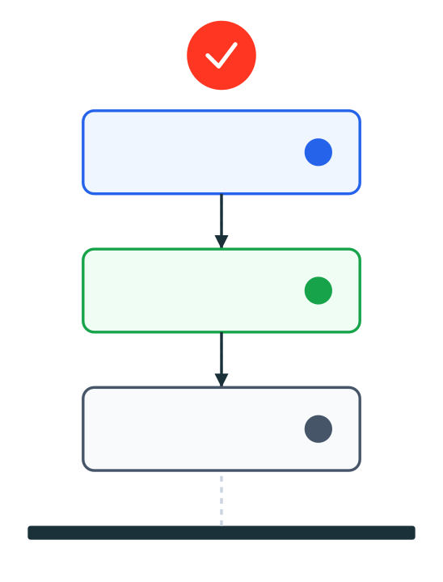


MODULE 06
MLflow Governance — For Data & Models
Establishing rigorous lifecycle controls, traceability, and auditability across experiments, model registry, and serving endpoints using Unity Catalog.
STEP 1
STEP 2
STEP 3
ML Lifecycle Control Plane
Traceability
Control
Visibility
Lineage & Metadata
Gates & Policies
Drift & Monitoring

Slide 70













MODULE 6
|
Governance & Architecture
MLflow Governance — Overview
Lifecycle Controls & Auditability
Unity Catalog Enforced
Unity Catalog Governance Perimeter
RBAC Enforced
PII Tags Active
Audit Trail
System Tables
Data Table Updated
2026-01-18 09:15:00 UTC
Data Engineer
Data Scientist
ML Engineer
MLOps
User: data_eng_1
Data
Training
Registry
Serving
Experiment Run Logged
2026-01-18 10:42:12 UTC
Feature Store
MLflow Exper.
Model Version
Model Serving
Delta Tables (Silver/Gold)
AutoML / Custom Runs
UC Model Schema
REST API / Batch
ID: run_9f82d... (Accuracy: 0.92)
PROD GATE
ver: 1.2
contracts
params
metrics
signature
condabench
Risk & Compliance
endpoint
latency
Model Registered
2026-01-18 11:05:00 UTC
Version 1.0 @ Staging
Lakehouse Monitoring: Drift, Freshness & Performance
Transition Approval
2026-01-18 14:20:00 UTC
Approver: risk_admin
© 2026 Enterprise ML Governance
70
Endpoint Scale-up
2026-01-18 14:25:00 UTC
Automatic (Target: <50ms)

Slide 71




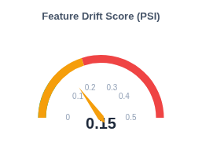
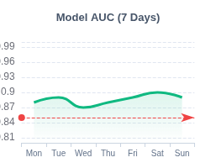
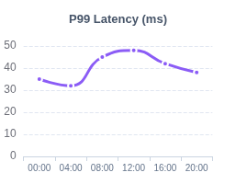



MODULE 6
MLflow Governance & Observability
Observability Signals
Monitoring Data Freshness & Feature Drift
Data Sources
Model Serving Logs
FRESHNESS (P95)
MAX DRIFT (PSI/KS)
MODEL PERF (AUC)
Payloads & Latency
12m
0.15
0.89
OK
High
+0.02
Target: < 15 min
Alert: > 0.20
Baseline: 0.85
System Tables
system.billing.usage
SERVING LATENCY (P99)
ERROR RATE
PREDICTION VOL (24H)
Lakehouse Monitoring
45ms
0.02%
2.4M
Profile Metrics & Drift
-3ms
Stable
+5%
SLA: < 100ms
Threshold: < 1%
Capacity: 5M
Real-time Monitoring & Trends
AUTOMATED ACTIONS
Trigger Retrain
Rollback Canary
PagerDuty Alert

Slide 72







Explainability for Business & Regulatory
Interpretable AI techniques and compliance artifacts for the Lakehouse
SHAP & Attributions
Regulatory Artifacts
Decompose predictions into feature contributions (Global & Local). Use for detailed "why" analysis on individual outcomes.
Model Cards & Datasheets
PDP / ICE & Permutation
Top Driver Summaries
Visualize marginal effects and feature importance ranking. Best for understanding macro-level model dependencies and trends.
Stability & Fairness Snapshots
Counterfactuals
Approval Workflow & Evidence Export
Generate "what-if" scenarios (e.g., "If income was $5k higher..."). Critical for actionable insights and recourse logic.
GOVERNANCE OUTPUTS
Model Card
Fairness Report
Audit Log
Approval Chain
Module 6 — MLflow Governance for Data & Models
Confidential & Proprietary

Slide 73

GENSPARK
1-HOUR WORKSHOP MODULE
Module 7 — Retail/CPG QE Solutioning Case Study (Workshop)
1 Hour | Group Activity
Product Master & Inventory Quality Validation
Outcomes: Faster insights, reduced escalations
Presented by: Ajay
Date: January 2026
Enterprise Quality Practice

Slide 74
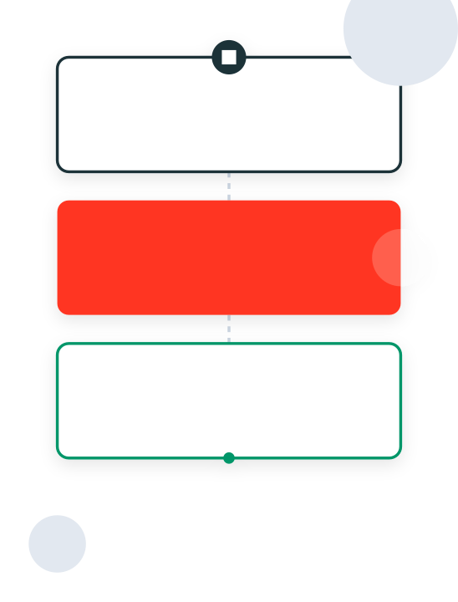

MODULE 07 | WORKSHOP
Workshop — Case Brief
Designing robust validations, defining SLOs, and mapping business outcomes for Retail/CPG data products in a hands-on session.
STEP 1
STEP 2
STEP 3
Workshop Flow
Design
Define
Map
Validations & Logic
SLOs & Thresholds
Business Outcomes

Slide 75





MODULE 7 — RETAIL/CPG QE SOLUTIONING CASE STUDY
Template: canvas_one_pager
Case Canvas — Product Master & Inventory
Workshop Artifact
M7
Use Cases & Value
Inputs & Sources
Quality SLOs
Primary Goal: Unified view of product attributes and near-real-time inventory availability.
ERP (SAP)
POS (Oracle)
WMS Feeds
Agreed Service Level Objectives
BUSINESS OUTCOMES
DATA ELEMENTS
SKU Master (UPC, dimensions, category)
FRESHNESS
Fill-rate Uplift: Reduce OOS (Out of Stock) events by 8%.
Store/Warehouse Stock Movements
≤ 30 Mins
Returns Reduction: Decrease returns due to bad description/data by 5%.
Real-time Sales Transactions
From POS scan to Dashboard
Velocity: Faster SKU onboarding (Days to Hours).
COMPLETENESS
≥ 99.5%
Transformation Logic
Outputs & Interfaces
Required attributes populated
Key Logic: Survivorship for Golden Record & Stock Recon.
Primary Tables: `gold.product_master`, `gold.inv_snapshot`
ACCURACY
PROCESSING STEPS
Interfaces: BI Dashboard & Operational API.
± 0.5%
Dedup: Merge duplicate SKUs across regions.
CORE SCHEMA
Variance vs Physical Count
Standardize: Unit conversions (e.g., cases to units).
sku_id, store_id, on_hand, available_to_promise, last_updated
Reconciliation: WMS vs. POS stock adjustments.
AVAILABILITY
Observability
ACTIVE
≥ 99.9%
Monitoring: Incidents & Breaches
API Endpoint Uptime
Consumers & Access
Governance & Owners
© 2026 Retail/CPG Quality Engineering Workshop. Confidential.
Inventory Owner
Data Steward
75
Stakeholders: Supply Chain Ops, E-commerce, Merchandising.
Ops Lead
MDM Team
ACCESS POLICIES
Criticality
Update Freq
TIER 1 (High)
Streaming
Row-level security by Region/Store ID.
`merch_analyst`: Read access to Product Master.
`ecom_service`: API access to Inventory.

Slide 76











MODULE 7 — WORKSHOP
Group Activity — Steps & Deliverables
30–40 Mins
PREREQUISITES
Activity Walkthrough
DELIVERABLES
Sample Schema
1 Slide: Architecture
Product Master & Inventory tables
1
Prioritize Validation Checks
Validation points in flow
Identify the most critical data quality rules for Retail/CPG data products to prevent downstream failures.
1 Slide: SLO Scorecard
Incidents Baseline
Targets & thresholds
Historical error rate data
Product ID Integrity
UPC Deduplication
1 Slide: Business Outcomes
SLO Targets
Impact & ROI narrative
Draft performance goals
Negative Stock Check
UOM Mismatches
Business Glossary
SKU & Stock definitions
2
Define SLO Thresholds & Alerts
Set quantifiable boundaries for freshness and accuracy to trigger incident responses.
RESOURCES
FRESHNESS
ACCURACY
AVAILABILITY
PRO TIP
< 30 Mins
> 99.5%
> 99.9%
retail_schema_v1.pdf
Reference Schema
Start with the highest financial impact failures (e.g., negative stock blocking checkout) to demonstrate immediate ROI.
cpg_slo_template.pptx
3
Map Validations to Business Impact
Scorecard Template
Connect data failures directly to real-world business consequences to justify QE investment.
Confidential — Training Material
76
Negative Stock
Lost Sales / Customer Frustration
Bad UPC
Checkout Failures / Margin Leakage

Slide 77






GENSPARK
MODULE 8
Module 8 — RFP Narrative & Final Architecture Pitch
30 Minutes
QE Differentiation & Pitch Templates
Skills Roadmap & Certifications
Presented by: {Presenter Name}
Date: {MM/DD/YYYY}
{Organization/Team}

Slide 78









QE Differentiation Storyline — Risk • Velocity • Cost
Positioning QE as a strategic differentiator in proposals: De-risking, accelerating, and optimizing
RISK / TRUST
VELOCITY
COST / TCO
Compliance & Reliability
Speed to Insight
Efficiency & ROI
PROPOSAL VALUE PROPS
PROPOSAL VALUE PROPS
PROPOSAL VALUE PROPS
40-60% reduction in incidents
25-35% faster time-to-insight
License avoidance (Native tools)
Audit-ready lineage & history
CI/CD native validation
Simplified ops & maintenance
Guaranteed SLO adherence
AI agents for RCA & Search
Auto-rule generation (GenAI)
Proactive PII governance
Automated deployment gates
Unified compute model
Win Theme
Assured Delivery
Win Theme
Accelerated Value
Win Theme
Optimized TCO
Key Metric
Incident Rate / MTTR
Key Metric
Cycle Time
Key Metric
Total Cost of Quality
EVIDENCE &
PROOF POINTS
KPI Baselines
|
Before/After Cases
|
Reusable Templates
Benchmarked Data
Real-world ROI
Accelerators
2026 Databricks Quality Engineering Strategy
Module 8 — RFP Narrative & Final Architecture Pitch

Slide 79












MODULE 8 — ARCHITECTURE PITCH
Reference Architecture & QE Differentiation
Target State: Unified Governance, Native Validation & AI Extensions
Repos & Git Integration
PR Gates: Contract Validation & Unit Tests
Orchestration: Rollback & Failure Routing
Databricks Workflows
MEDALLION ARCHITECTURE
Ingest (Bronze)
Curate (Silver)
Serve (Gold)
AI EXTENSIONS
Auto Loader
Delta Live Tables
SQL Warehouse
MODEL GOVERNANCE
SOURCES
MLflow Registry
Schema Enforcement
DLT Expectations
SLA Monitors
Quarantine Logic
Delta Constraints
Business Rules
GENAI / RAG
Cloud Files
Vector Search
Data Contracts
Operational DB
OBSERVABILITY
Kafka Streams
Lakehouse Monitoring
System Tables
Alerting & Incidents
Access Control
Lineage
Metadata
Databricks Native
Unity Catalog
Audit
Fine-grained RBAC
Column-level Traceability
Tags & Classification
QE Control Overlay
Unified Governance, Lineage & Discovery Layer
Compliance Logs
AI Extension

Slide 80




















MODULE 8 — WRAP UP
Enablement Plan
Skills Roadmap & Certifications
FY2026 Q1-Q2
TRACK
NOW
NEXT
LATER
0–30 DAYS
30–90 DAYS
90–180 DAYS
Recommended Certifications
Unity Catalog
Lineage Policy
System Tables
Databricks Academy
Setup Metastore, Catalogs, and initial RBAC groups.
Enforce lineage capture and column-level masking policies.
Automate audit reporting and usage cost attribution.
Platform & Governance
Foundation
Platform Eng
Data Stewards
FinOps
Lakehouse Fundamentals
DLT Expectations
Data Contracts
Scorecards
BASELINE
Implement preventive rules in Bronze/Silver pipelines.
Integrate PR-based contract validation in CI/CD.
Publish exec-level DQ dashboards with SLAs.
QE Automation
Quality Gates
QE Leads
Data Eng
Product Owners
Data Engineer Professional
CORE QE SKILL
Vector Search
RCA Agent
Auto-Rules
Index documentation and runbooks for retrieval.
Deploy RAG agent for incident root-cause analysis.
GenAI loop to propose new expectations from data.
AI Agents & RAG
Machine Learning Specialist
Innovation
AI Team
QE + Ops
QE Leads
ADVANCED
Tracking
Registry Gates
Drift Monitor
Standardize experiment tracking and signatures.
Enforce approval workflow for Staging/Prod promo.
Automated feature drift detection and retraining.
PRO TIP
MLOps / MLflow
Complete "Lakehouse Fundamentals" within the first 30 days to align terminology across the team.
Model Gov
Data Scientists
ML Eng
MLOps

